Slide 1
Software Engineering Background, Motivation, & Methodologies
CS 1530
Summer 2020
Instructor: Sohel Sarwar
University of Pittsburgh
Lecture 1

Slide 2
Objective
Background
SOFTWARE CHRACTERISTICS
SOFTWARE ENGINEERING SUBDIVISIONS
SDLC
METHODOLOGIES
Waterfall
V-Model
Spiral
Iterative
agile
SDLC stages
Requirements Analysis
Design
Use Case DIAGRAM
ACTIVITY DIAGRAM
CLASS DIAGRAM
ARCHITECTURAL PATTERN
DESIGN PATTERN
Introduce & Apply Software Engineering Concepts to Solve Real Life Problems

Slide 3
Software Engineering
Background
METHODOLOGIES
SDLC stages

Slide 4
Software is basically…
A Computer Program that solves a real-life problem by computerizing and/or automating manual workflow.

Slide 5
But Software is not just about…
Programming Language (Java, C#, Python, etc.)
Object-Oriented Concepts
Data structures
Algorithms

Slide 6
Software is Multidimensional
Software Characteristics
Functionality
Usability & Efficiency
Reliability & Security
Maintainability
Scalability
Portability

Slide 7
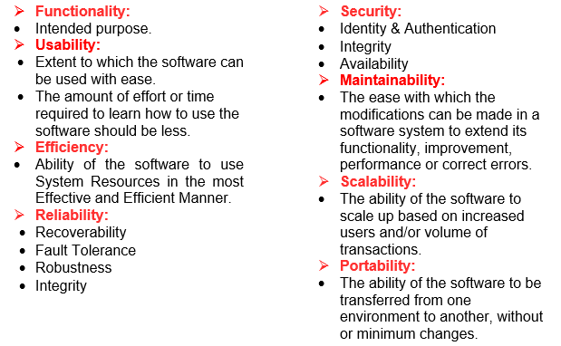
Software Engineering Software Characteristics
Software Characteristics
Functionality
Usability & Efficiency
Reliability & Security
Maintenability
Scalability
Portability

Slide 8
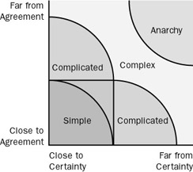

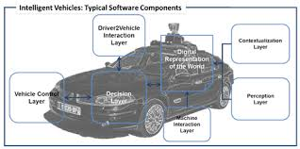
Multidimensionality Results in Software Complexity

Slide 9
A Complex System with Flawed Design Has Severe Consequences
Boeing 737 MAX 8 Incidents
After the first accident, Lion Air Flight 610 on October 29, 2018, investigators suspected that the MAX's new Maneuvering Characteristics Augmentation System (MCAS) automatically and repeatedly forced the aircraft to nosedive.
On March 10, 2019 Ethiopian Airlines Flight 302 crashed, despite the crew's attempt to use the recovery procedure.
In March 2019, aviation authorities around the globe grounded the 737 MAX passenger airliner after two new airplanes crashed within five months, killing all 346 people aboard.

Slide 10
A Complex System with Flawed Design Has Severe Consequences
Airbus A320 Incident
Software Malfunction caused crash of Strasbourg A320 on Jan 21, 1992 killing 87 people, the pilots had the flat panel display in the wrong mode.
The Airbus A320, while a highly safe and successful aircraft, was highly controversial in software engineering circles, being the first civilian Fly-by-wire aircraft. In the Airbus flight control systems, the computer has the final say on all decisions, meaning the safety of passengers depends upon the accuracy of the software specification.

Slide 11
A Complex System with Flawed Design Has Severe Consequences
Therac-25 Incidents
The Therac-25, a radiation therapy machine produced by Atomic Energy of Canada Limited (AECL) in 1982, was responsible for at least six accidents between 1985 and 1987, in which patients were given massive overdoses of radiation due to faulty software. The machine had concurrent programming errors, it sometimes gave its patients radiation that were hundreds of times greater than normal, resulting in death or serious injury.
These accidents highlighted the dangers of software control of safety-critical systems, and they have become a standard case study in health informatics and software engineering.

Slide 12

Software Engineering Tangible Impact of Intangible Product
Boeing 737 MAX 8 Incidents
Airbus A320 Incident
Therac-25 Incidents

Slide 13
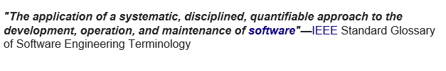
A Complex System Demands Thorough Engineering Approach
Software Characteristics
Requirement Engineering
Design & Construction
Quality Assurance
Configuration Management
Project Management
Process Engineering

Slide 14
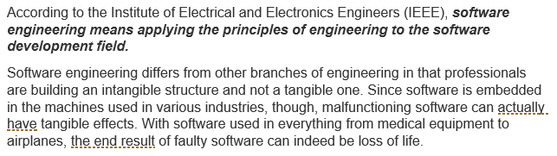
Software Engineering

Slide 15
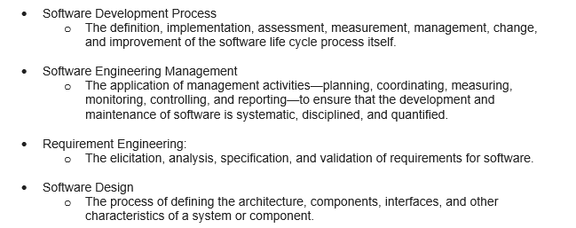
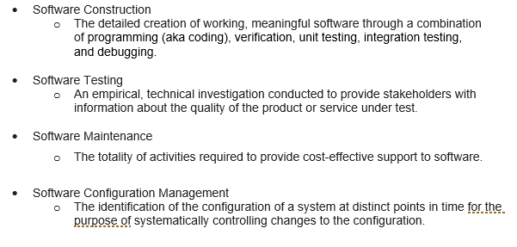
Software Engineering Sub-disciplines
Software Characteristics
Requirement Engineering
Design & Construction
Quality Assurance
Configuration Management
Project Management
Process Engineering

Slide 16
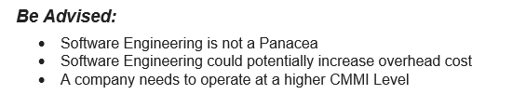
Software Engineering

Slide 17
Software Engineering Process Evaluation Framework: CMMI
Capability Maturity Model Integration (CMMI) is a process level improvement training and appraisal program.
Administered by the CMMI Institute, a subsidiary of ISACA, it was developed at Carnegie Mellon University (CMU).
CMMI can be used to guide process improvement across a project, division, or an entire organization.

Slide 18
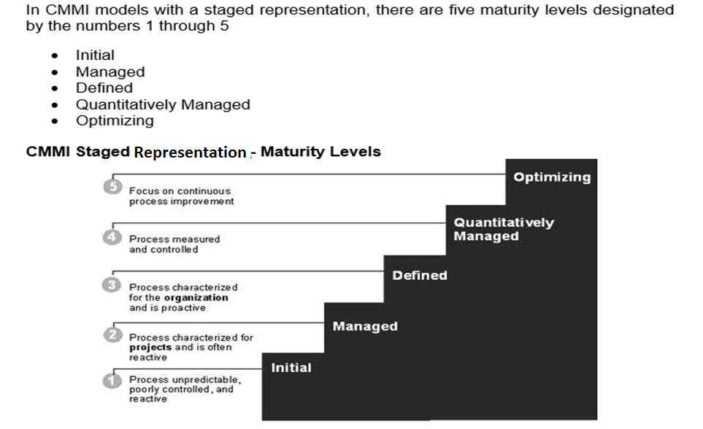
Software Engineering Process Evaluation Framework: CMMI

Slide 19
Software Engineering Process Evaluation Framework: CMMI
CMMI Levels:
Maturity Level 1: Initial
Unpredictable and reactive. Work gets completed but is often delayed and over budget.
Maturity Level 2: Managed
Managed on the project level. Projects are planned, performed, measured, and controlled.
Maturity Level 3: Defined
Proactive, rather than reactive. Organization-wide standards provide guidance across projects, programs, and portfolios.

Slide 20
Software Engineering Process Evaluation Framework: CMMI
CMMI Levels:
Maturity Level 4: Quantitatively Managed
Measured and controlled. Organization is data-driven with quantitative performance improvement objectives that are predictable and align to meet the needs of internal and external stakeholders.
Maturity Level 5: Optimizing
Stable and flexible. Organization is focused on continuous improvement and is built to pivot and respond to opportunity and change. The organization’s stability provides a platform for agility and innovation.

Slide 21
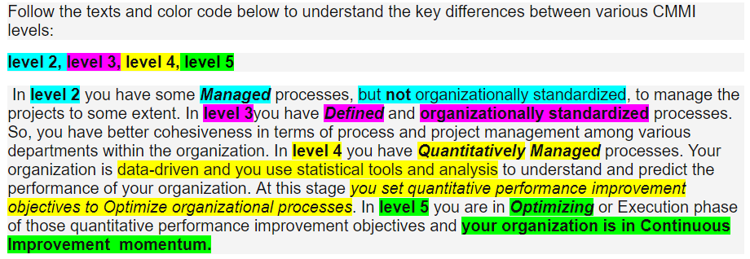
Process Evaluation Framework: CMMI
Source: https://cmmiinstitute.com/learning/appraisals/levels

Slide 22
Software Engineering Process Evaluation Framework: ISO
ISO/IEC 12207:2008 establishes a common framework for software life cycle processes, with well-defined terminology, that can be referenced by the software industry.
It contains processes, activities, and tasks that are to be applied during the acquisition of a software product or service and during the supply, development, operation, maintenance and disposal of software products.
Software includes the software portion of firmware.
Source: https://www.iso.org/standard/43447.html

Slide 23
Software Engineering Process Evaluation Framework: ISO
ISO/IEC 15504:2004 provides overall information on the concepts of process assessment and its use in the two contexts of process improvement and process capability determination.
It describes how the parts of the suite fit together and provides guidance for their selection and use.
It explains the requirements contained within ISO/IEC 15504, and their applicability to performing assessments.
Source: https://www.iso.org/standard/43447.html

Slide 24
Software Engineering Process Evaluation Framework: ISO
ISO 9001:2015 specifies requirements for a quality management system when an organization:
needs to demonstrate its ability to consistently provide products and services that meet customer and applicable statutory and regulatory requirements, and
aims to enhance customer satisfaction through the effective application of the system, including processes for improvement of the system and the assurance of conformity to customer and applicable statutory and regulatory requirements.
All the requirements of ISO 9001:2015 are generic and are intended to be applicable to any organization, regardless of its type or size, or the products and services it provides.
Source: https://www.iso.org/standard/43447.html

Slide 25
Software Engineering
Background
METHODOLOGIES
SDLC stages

Slide 26
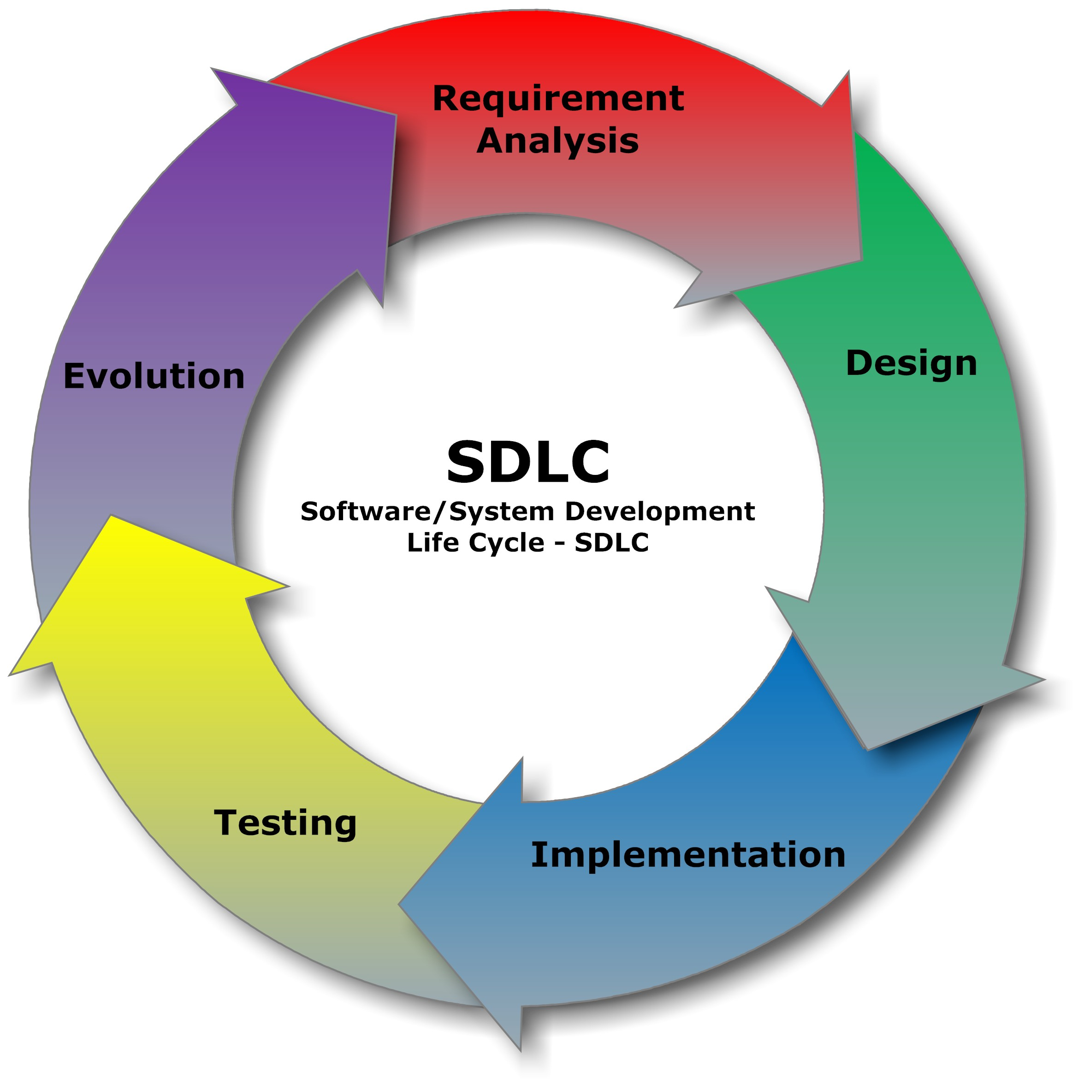
Software Development Lifecycle SDLC

Slide 27
Software Engineering SDLC
Software Development Life Cycle is a well defined and systematic approach, practiced for the development of a reliable high quality software system.

Slide 28
Software Engineering SDLC
The various stages of the Software Development Life (SDLC) are structured such a way that the result produced by one stage is fed to the next one. There are mainly five stages in the SDLC:
Requirement Analysis
The requirements of the software are analyzed and gathered at this stage. Various stakeholders collaborate at this stage by means of thorough discussions and analysis to determine the purpose, features, and functionalities of a software solution. Accordingly, a ‘Requirement Specification’ document is developed to be used as a guide for the next stage.

Slide 29
Software Engineering SDLC
Design
In this stage the software and system architecture, deign patterns, static and dynamic models are designed using the ‘Requirement Specification’ from the previous stage. The design stage also establishes what hardware is needed. The design documents from is stage is combined with the Requirement Specification from the previous stage to build comprehensive ‘Software Requirement Specification’ or ‘Product Requirement Document’., which is fed to the next stage for development.
Implementation & Coding
In this stage, the actual coding is done and the code is produced based on the design specifications. This is the most critical and also the longest stage in the SDLC.

Slide 30
Software Engineering SDLC
Testing
After the development of the code, it is tested to see if it meets all the requirements that were determined in the first stage. Various kinds of testing such as system testing, unit testing, acceptance testing, and integration testing are carried out.
Maintenance
This is the final stage, where the finished software is delivered to the customer. The real problems are identified once the customer begins use. These problems are addressed from time to time as they crop up.

Slide 31
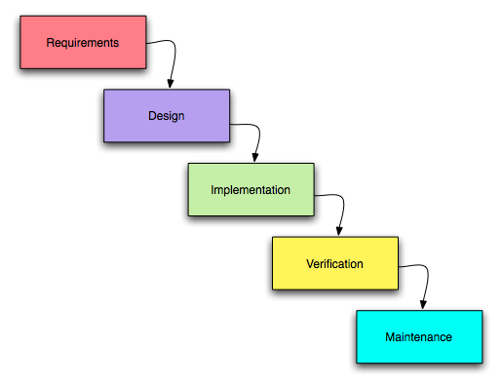
Software Engineering SDLC - Waterfall

Slide 32
Software Engineering SDLC - Waterfall
Waterfall model is the earliest SDLC approach that was used for software development.
The Waterfall Model illustrates the software development process in a linear sequential flow, hence it is also referred to as a linear-sequential life cycle model. This means that any phase in the development process begins only if the previous phase is complete. In Waterfall Model phases do not overlap.

Slide 33
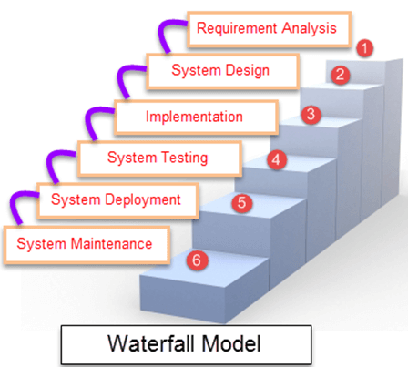
Software Engineering SDLC - Waterfall

Slide 34
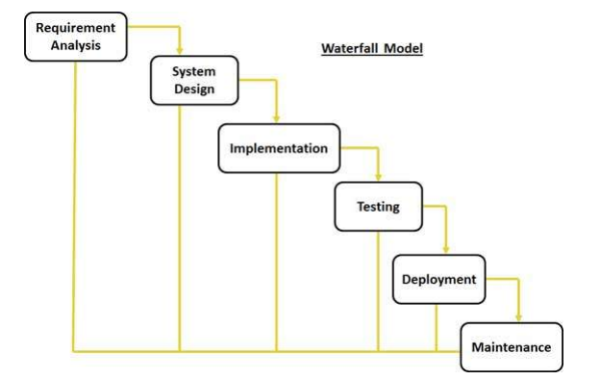
Software Engineering SDLC - Waterfall

Slide 35
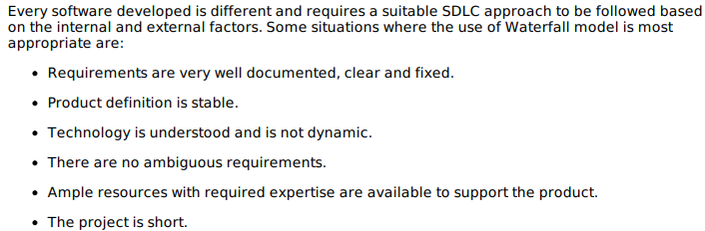
Software Engineering SDLC Waterfall

Slide 36
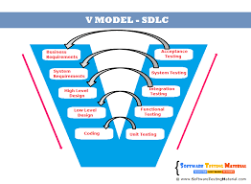
Software Engineering SDLC – V Model

Slide 37
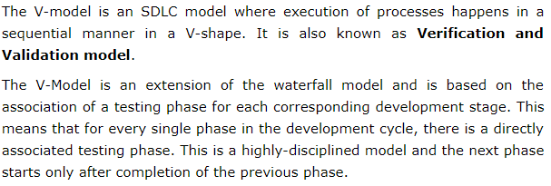
Software Engineering SDLC V Model

Slide 38
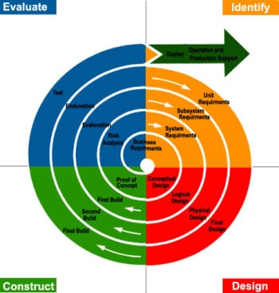
Software Engineering SDLC – Spiral Model

Slide 39
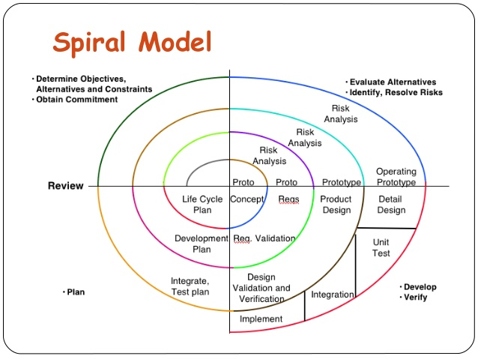
Software Engineering SDLC – Spiral Model

Slide 40
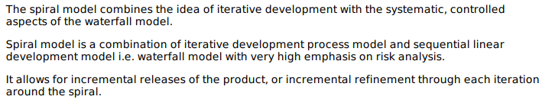
Software Engineering SDLC Spiral Model

Slide 41
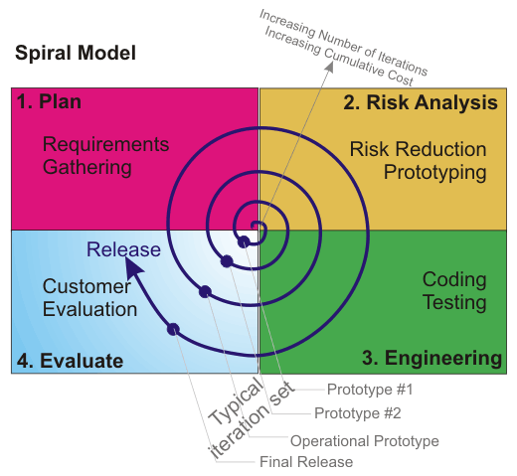
Software Engineering SDLC – Spiral Model

Slide 42
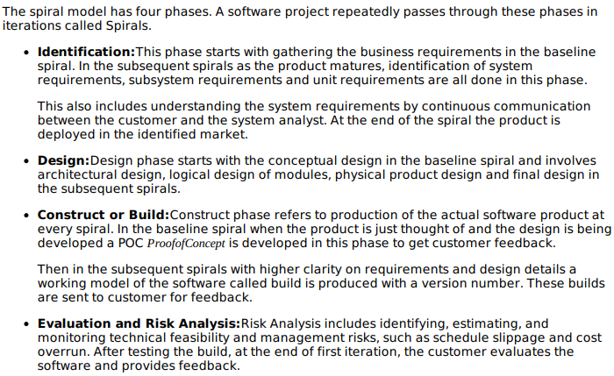
Software Engineering SDLC Spiral Model

Slide 43
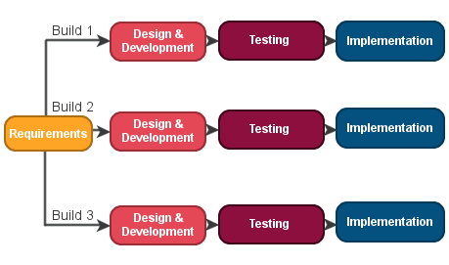
Software Engineering SDLC – Iterative

Slide 44
Software Engineering SDLC – Iterative
An Iterative Life Cycle Model does not start with a full specification of requirements.
In this model, the development begins by specifying and implementing just part of the software, which is then reviewed in order to identify further requirements.
Moreover, In Iterative Model, the iterative process starts with a simple implementation of a set of the software requirements, which iteratively enhances the evolving versions until the complete is implemented and ready to be deployed.
Each release of Iterative Model is developed in a specified and fixed amount of time, which is called iteration.

Slide 45
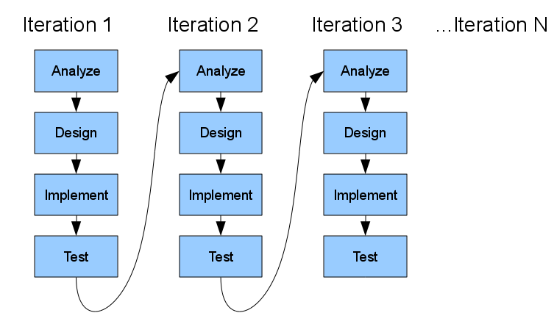
Software Engineering SDLC – Iterative

Slide 46
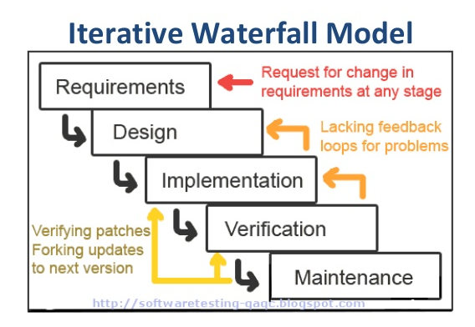
Software Engineering SDLC – Iterative

Slide 47

Software Engineering Agile

Slide 48
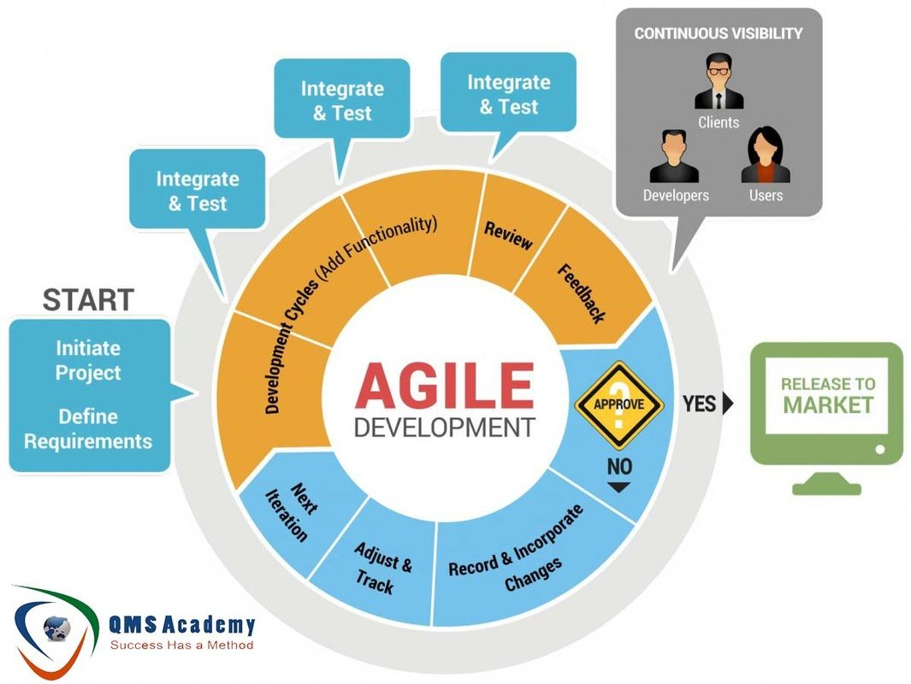
Software Engineering SDLC – Agile

Slide 49
Software Engineering Agile

Slide 50
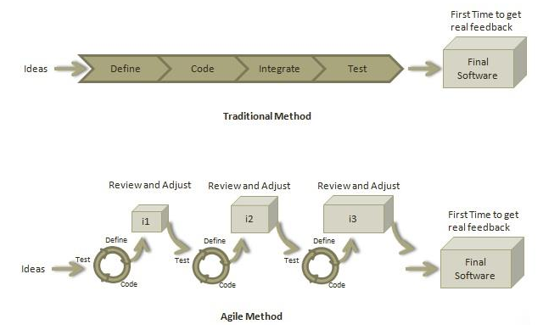
Software Engineering Agile

Slide 51
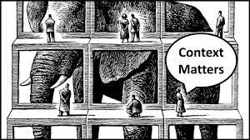
Apply Software Engineering Approach to Real Life Problem
Problem Statement 1 – Vending Machine:
In response to an RFP (Request For Proposal) to win a contract within a fast turn around time, create a Proof of Concept (POC) or Minimum Viable Product (MVP) for a Soda Vending Machine Software System, which will allow the customers to select soda of choice and make payment using just Bills and Coins. The system should be able to dispense changes if Bills or Coins are used. The Vending Machine can be accessed by the Maintenance Crew to restock or remove products as well.
SDLC Methodology Selection:
Since it is a POC or MVP, so the scope is minimum and project duration is short. Also, the scope is quite understood & fixed. So, we can adopt Waterfall SDLC Methodology.

Slide 52
Apply Software Engineering Approach to Real Life Problem
Problem Statement 2 - Ventilator:
In response to an RFP (Request For Proposal) to win a contract within a fast turn around time, create a Proof of Concept (POC) or Minimum Viable Product (MVP) for a Ventilator Machine Software System, which will assist COVID-19 Patients to breath. The rate of breathing and the oxygen level for the machine can be adjusted easily.
SDLC Methodology Selection:
Since it is a POC or MVP, so the scope is minimum and project duration is short. Also, the scope is quite understood & fixed. Since, the product has critical life saving application, so the quality control must be very strict. So, we can adopt V-Model for the development.

Slide 53
Apply Software Engineering Approach to Real Life Problem
Problem Statement 3: Small Company Product Innovation:
A small company with very limited resources intends to innovate for sustenance and would like to adopt a near long term development strategy. It plans to build out the product gradually from smaller scope to incrementally larger scope by taking market validation carefully. Also, it can’t afford diverting significant resources to this initiative at once at the onset in order to minimize revenue loss risk by continuing with the existing product lines. But it is committed to channel more resources incrementally over time. Also, it intends to be flexible with technology over time.
SDLC Methodology Selection:
Limited resources, long term project, & gradual development criteria suggest that the development methodology must have iterations. From smaller scope & resources to incrementally larger scope & resources suggest variable lengths of iterations. Risk management and flexible technology adoption and the other identified points suggest the adoption of Spiral SDLC Methodology.

Slide 54
Apply Software Engineering Approach to Real Life Problem
Problem Statement 4: Large Company Product Innovation:
A large/mid sized company with sufficient resources intends to innovate for sustenance and would like to adopt a near long term development strategy. It plans to build out the product incrementally. by taking market validation carefully. Also, it dedicates certain number resources to this initiative to ensure fixed development cadence. Also, it intends to be flexible with technology over time and plans to allow skill development of the resources as needed through out the life span of the project.
SDLC Methodology Selection:
Long term project and incremental development criteria suggest that the adopted development methodology must have iterations. Fixed resources and cadence suggest that iteration lengths must be constant. Flexible technology adoption & skill development strategy suggest the adoption of Iterative model. So, we can adopt Iterative SDLC Methodology.

Slide 55



Software Engineering Tools
Github

